Slide 1
AI & Skin Cancer Detection On the Cloud
By: Evan Hanson
Anirudh Ambore
Wonjun Choi
Ziyad Alqahtani
Abdelrahman Mohammed
Mishari Alharbi

Slide 2
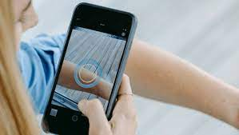
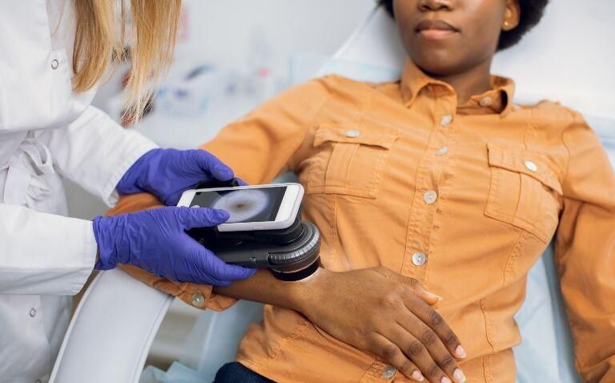
Project Goals and Vision
Goals
Classify skin lesion images as malignant or benign
Compare the accuracies of different models
*MobileNetV2, Inceptionv3
Utilize AI/ML and Cloud computing
Benchmarking on the Cloud
Create an application with Flask and deploy it on AWS/GCP
Project Vision
Patients: Allows users to test for skin cancer
Healthcare Providers: Presents new avenue for professional testing
Healthcare Organizations: Benchmarking to help set a baseline for future research in cloud computing
System Performance: Available to users regardless of hardware restrictions

Slide 3
Simplified Conceptual Sketch
User Interface & Accessibility
Simple web app created with Flask
AI Model for Accurate Diagnosis
Trained on the Cloud to classify malignant/benign images
Cloud Deployment
Hosted on AWS/GCP
Improves scalability, accessibility, sustainability

Slide 4
System Design: AI/ML
Our system design comprises the following:

Slide 5
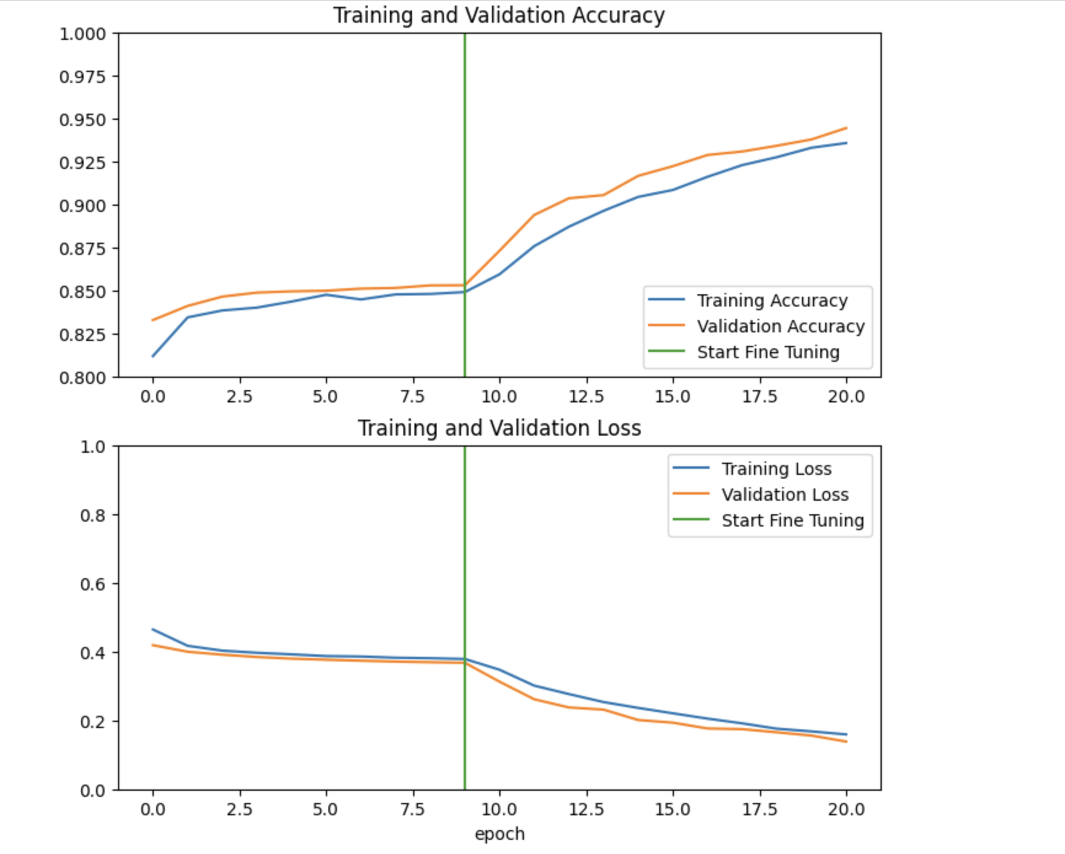
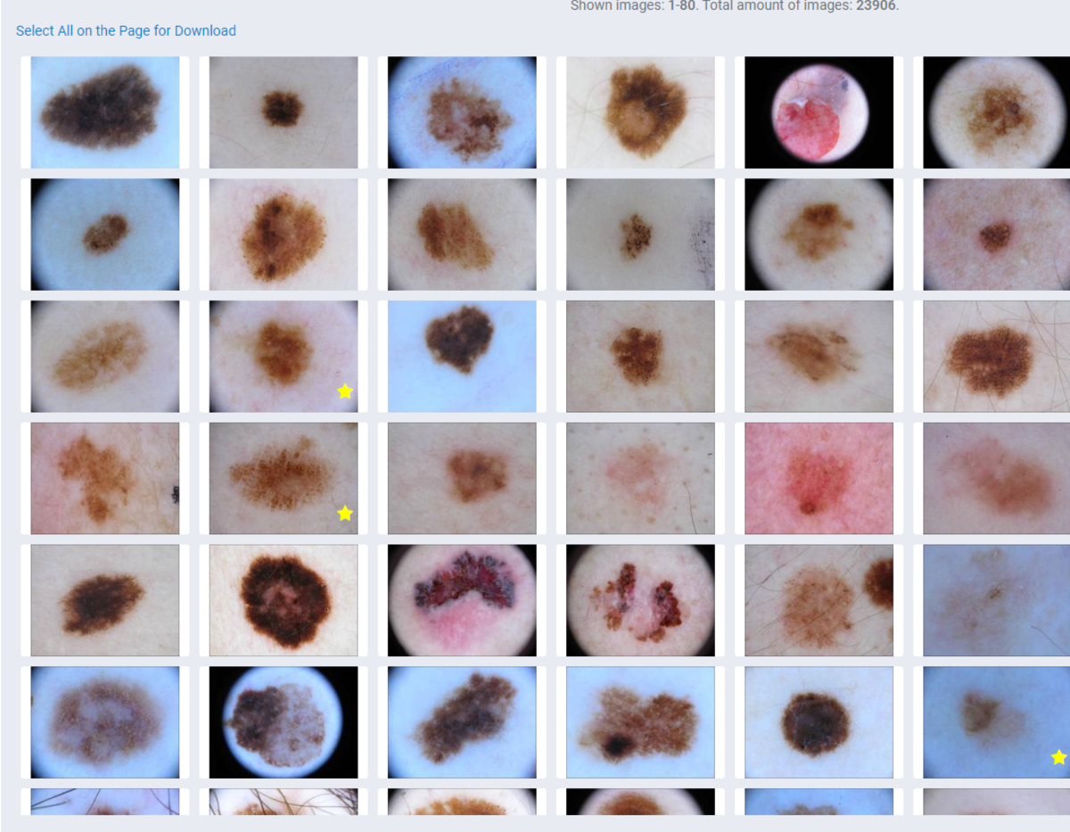
Prototype Implementation - AI Transfer Learning
For the implementation of AI model, we use the TensorFlow/Keras framework and train it on AWS ec2/GCP VM
Data Preparation: ~11K images are loaded from ISIC and processed for testing and validation.
Model Building: A pre-trained convolutional neural network (MobileNetV2) is introduced to learn new patterns.
Model Training: The model is trained on the Cloud t o recognize cancerous features from images.
Evaluation: The model’s metrics are assessed on unseen data and and fine-tuned.
Deployment: The model is integrated into the web application to make predictions.
Notes:
Data Prep: Gather 11,000 benign/malignant skin lesion images from the ISIC database. Standardize the data, add labels indicating cancer presence.
Model Building: Choose suitable machine learning models for image classification MobileNetV2 freezes the layers of the base model (except the last few) to prevent them from being updated during training, allowing the model to leverage pre-learned features while focusing on learning task-specific patterns.
Model Training: Train the selected mode on the Cloud to recognize cancerous features from images.
Model Evaluation: Assess model performance on unseen datasets, measuring metrics. Then, we Fine-tune the model based on evaluation results to improve it.
Deployment: Integrate the trained model into a user-friendly application deployed on AWS and GCP

Slide 6
Transfer Learning
InceptionV3 - MobileNetV2
MobileNet Specializes in small low-latency/power-usage with the focus for embedded systems
Freezing layers
Keep layers with desired pattern recognition
Train on the new dataset (ISIC - Skin Cancer Images)
Fine tuning
Adjusting Parameters (Output layers)
Reduce Overfitting/Underfitting
Great for specialized use-cases

Slide 7
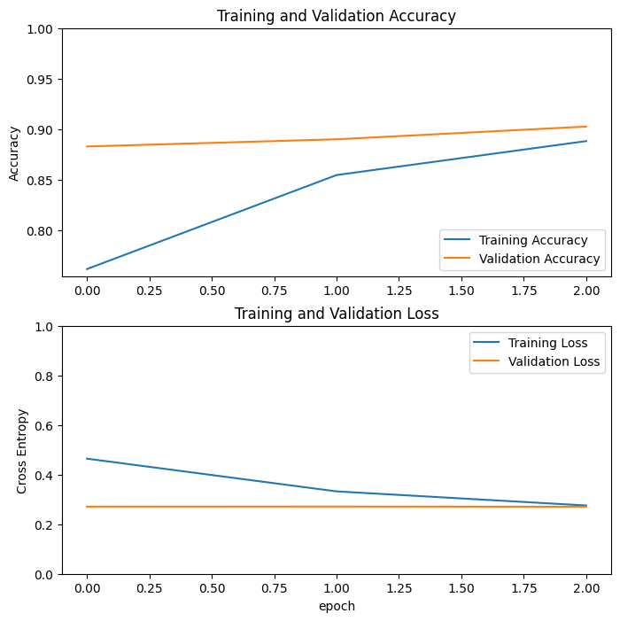
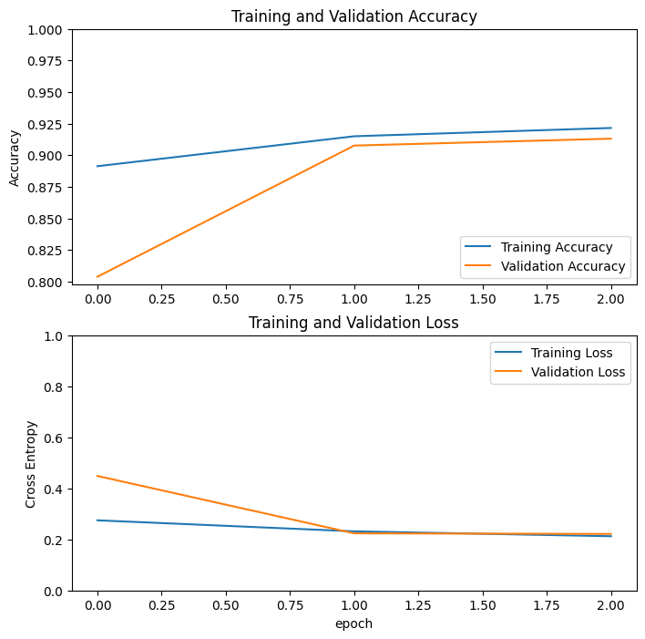
Accuracy Metrics
AWS
GCP

Slide 8
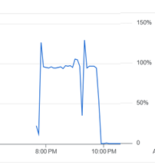
Metrics on the Cloud- AWS/GCP
Results from Training on AWS
Total training time: 126.5 minutes
Evaluation time: 2 minutes
Test accuracy: 88.9%
Results from Training on GCP
Total training time: 121.1 minutes
Evaluation time: 0.6 minutes
Test accuracy: 90.6%
CPU Utilization (%) in AWS (Left) and GCP (Right)

Slide 9
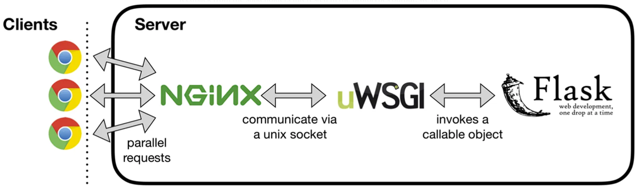
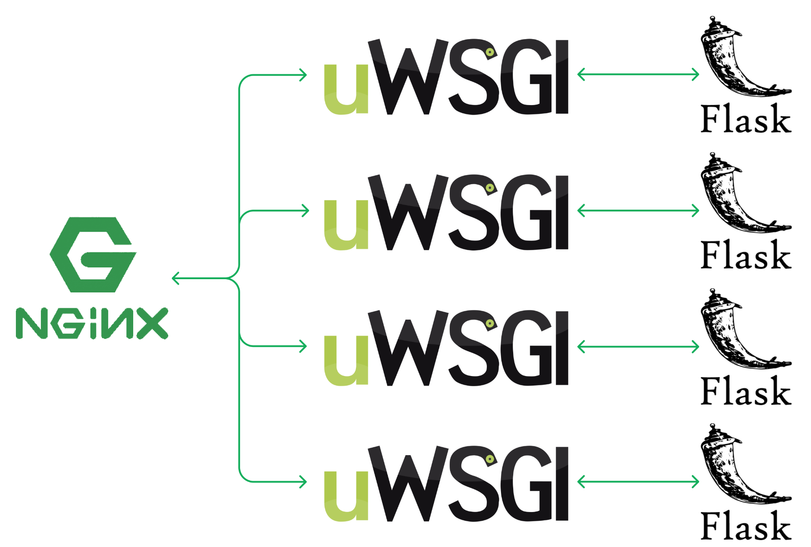
AWS - Structure of Server
• Web Server : NginX
• WSGI (web server gateway interface): uWSGI
• Web Application Server : Flask
Load Test Results (500 user load)
with a single process
Missing some results
Server fails and freezes
with 4 processes
Saved the results of all requested images
Continuously maintain and handle load
Notes:
I explain the server structure in the AWS cloud.
we configured the server by connecting the web server to the flask application like first image.
we decide to use nginx and uwsgi, the reason is that NGINX and UWSGI can use concurrent processes.
After setting it up, we tested to increased the traffic with a scenario of 500 user uploading, and here are the results.
When we used one process, we experienced missing results or server freezes.
However, when we used 4 processes, we saw that all the results were saved and the server was running continuously.

Slide 10
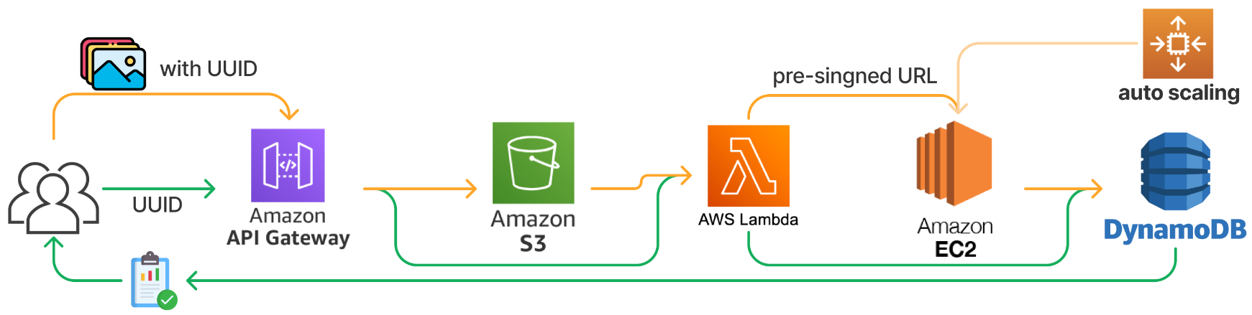
AWS Architecture
Serverless Architecture
Designed for easy maintenance and high traffic
Image Processing with AWS Lambda
Security and accuracy
UUID for Data Uniqueness
Pre-Signed URLs for Secure Data Transfer
Scalability (auto scaling)
Maintain performance even as high traffic
Capable of providing non-stop services.
Notes:
I talk about the AWS cloud architecture.
this architecture is designed as a serverless architecture for easy maintenance and high traffic, so we used lambda services to increase security and accuracy and configured it in serverless form.
This architecture uses two methods to increase security and accuracy
First, we used UUID that never overlap with other users and results to be stored in a key-value format using uuid.
Second, we made lambda service to use an pre-signed URL for security when processing images.
we have configured auto scaling for scalability
This feature automatically creates and spins up identical instances when high traffic occurs.
so, performance can be maintained even with high traffic, and the service can continue to serve users without interruption.

Slide 11
GCP Architecture
Using Google Cloud services such as Cloud Run, Compute Engine, and Cloud Storage.
Cloud Run uses the default type of Compute Engine service with broad IAM permissions.
Cloud Storage stores the app resources, such as images, prediction percentages, and software packages.
Notes:
We used the different cloud service that GCP offers to run and deploy our Flask app.
The cloud run uses the default type of Compute Engine which offers broad IAM permission so any member in our group can control all of the infrastructure.
The cloud storage is used to store the app resource, like software packages and images used for the UI, not to be confused with the images the user uploads.

Slide 12
Learning Adaptation & Challenges
AI
Transfer learning
Training the model on Cloud
Cloud
Using Flask instead of Flutter
Challenges
Lack of dataset with darker skin color
Model creating
Notes:
Our learning adaptation was in 2 section:
In AI, we used the feedback we received to seek transfer learning, which is using pre-trained models to improve the AI prediction.
We also learned to train the model on the cloud so we can create some benchmarking to get the metrics and compare the results.
In cloud, we learned that using Flask was a better option because it is more suitable to be deployed on the cloud and had a shallow learning curve in contrast to Flutter
We have faced many challenges throughout the two semester but the main ones were:
1. Finding datasets of darker skin color, which was difficult because of the scarcity of such dataset
2. creating an AI model from scratch, which we replaced with transfer learning

Slide 13
Thank you!
Notes:
THANK YOU FOR LISTENING

